Slide 1


Chapter III - 2025
COPYRIGHT (C) 2025, ECLIPSE FOUNDATION

Slide 2
PITCHING SESSION A - kiki✊✊
COPYRIGHT (C) 2025, ECLIPSE FOUNDATION

Slide 3


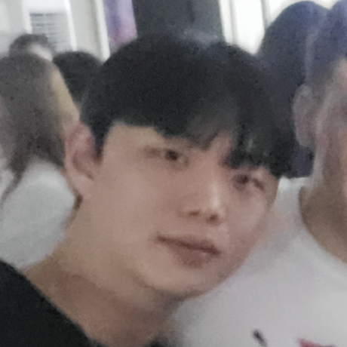
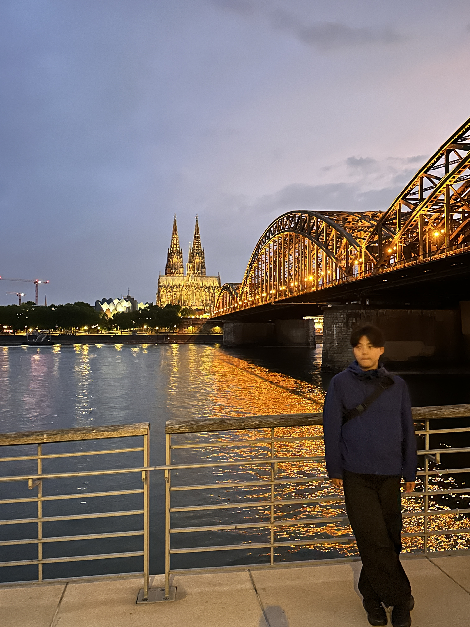

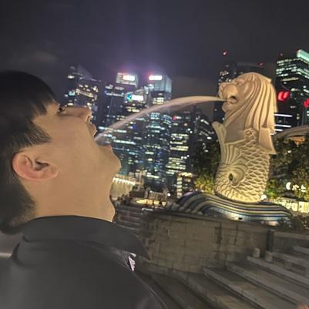
Team – A kiki
Juhun Kang
(Leader)
Infrastructure& Integration Team
Dongmin Jang
Chase Police Team
Minhyeok choi
Chase Police Team
Jeongmin JO
Encirclement Police Team
Jaehong Lim
Encirclement Police Team

Slide 4
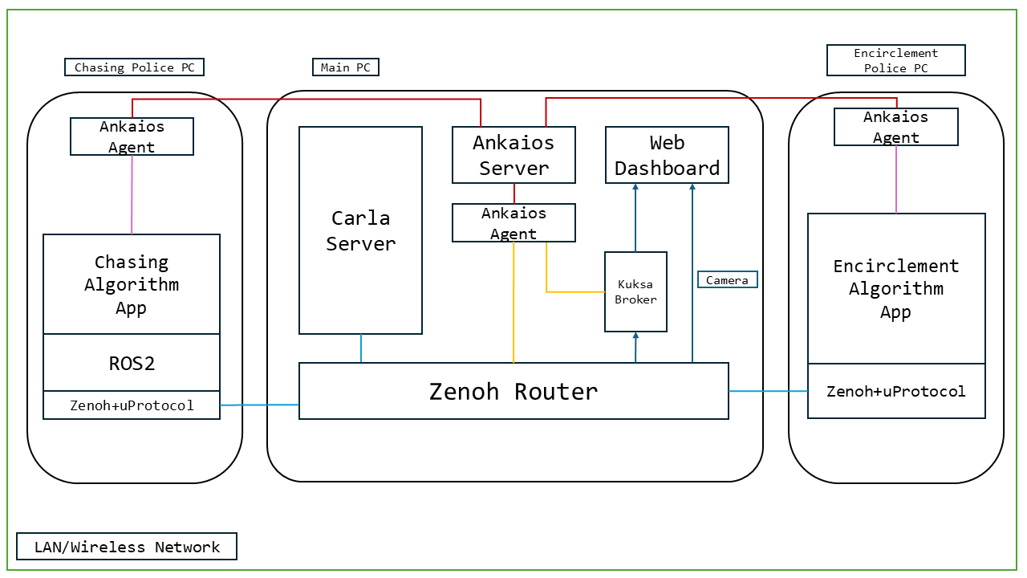
Plan
Initial Situation:
Pedestrains waling on crosswalk / Hit-and-run occur
Our solution:
Enhanced Auto-Police System
> detect themselves, communicate themselves, and arresting themselves!
Idea & Plan:
Leverage CARLA, ROS2, Zenoh, and Kuksa, Ankaios to build an autonomous police system

Slide 5
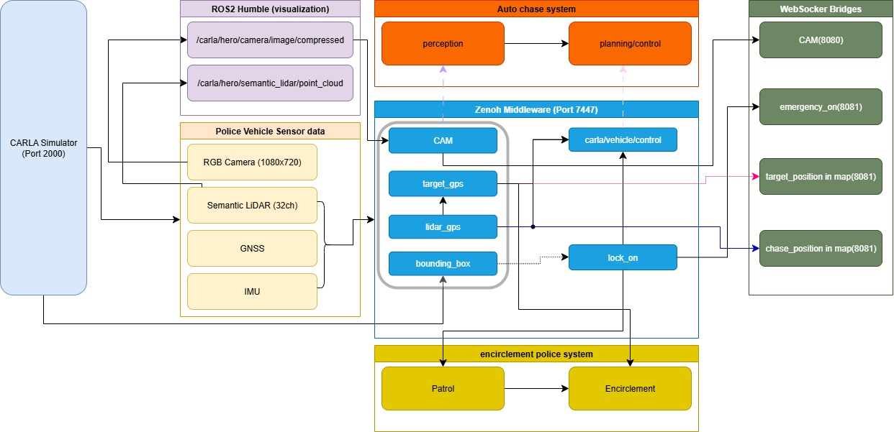
Project Structure

Slide 6
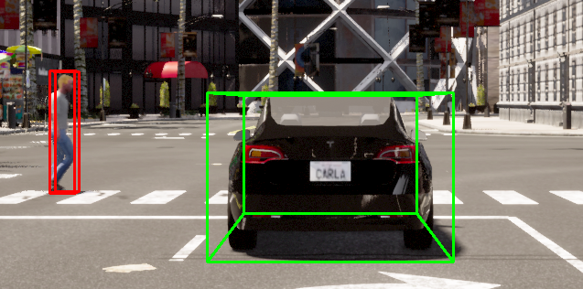
Perception
Detect accident
Detecting Bound box center point position change

Slide 7
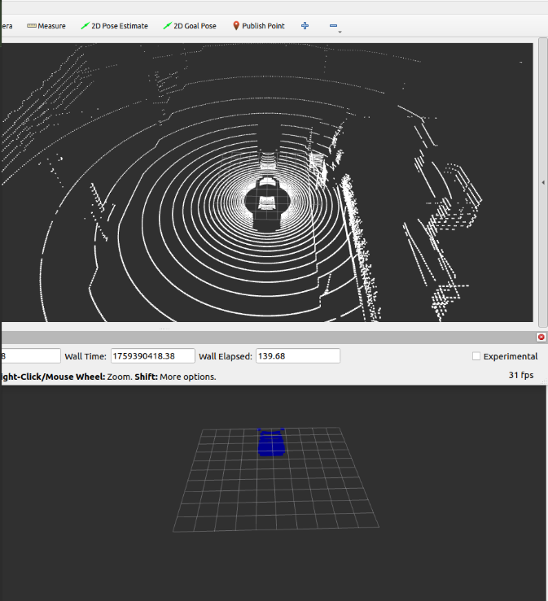
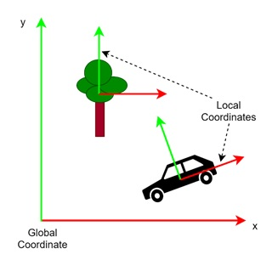

Perception
~4분
How to know
Calculate car’s global position with Combined data GPS,IMU, lidar
GPS + IMU

Slide 8
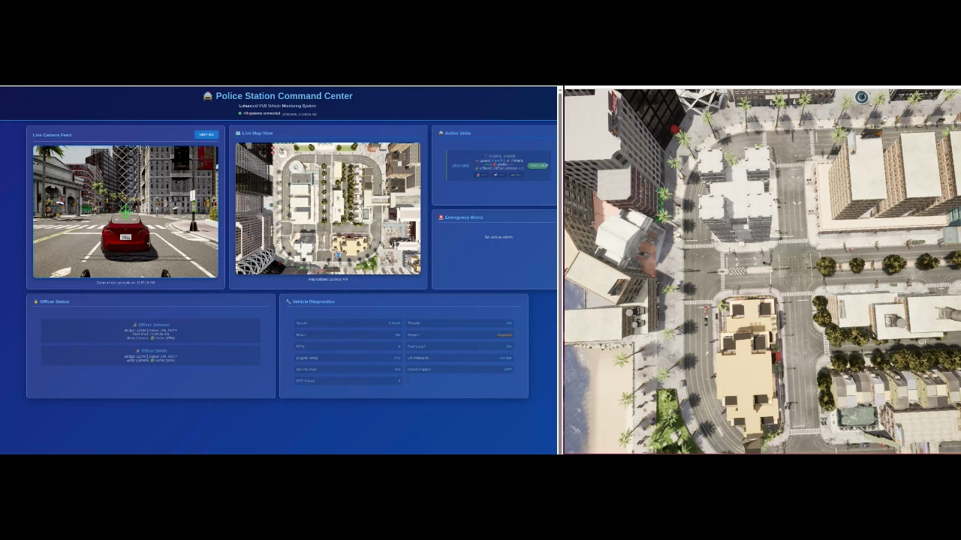

Slide 9
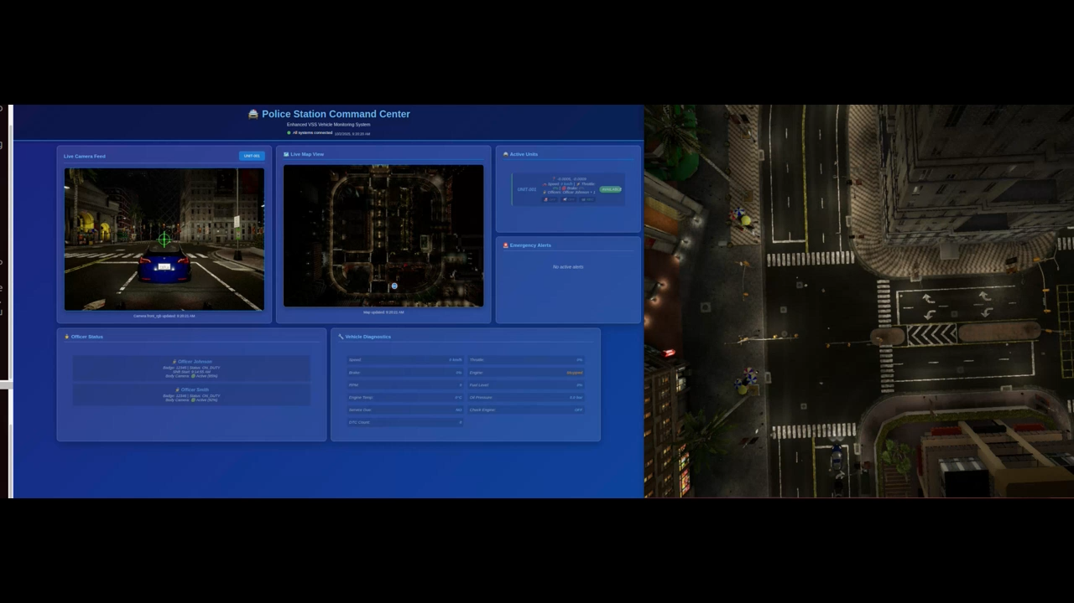

Slide 10
Why we built this? (Value of our service)
Driver Overload
Imperfect Coordination
Visual Blackout
Night Time Pursuit Difficulty

Slide 11
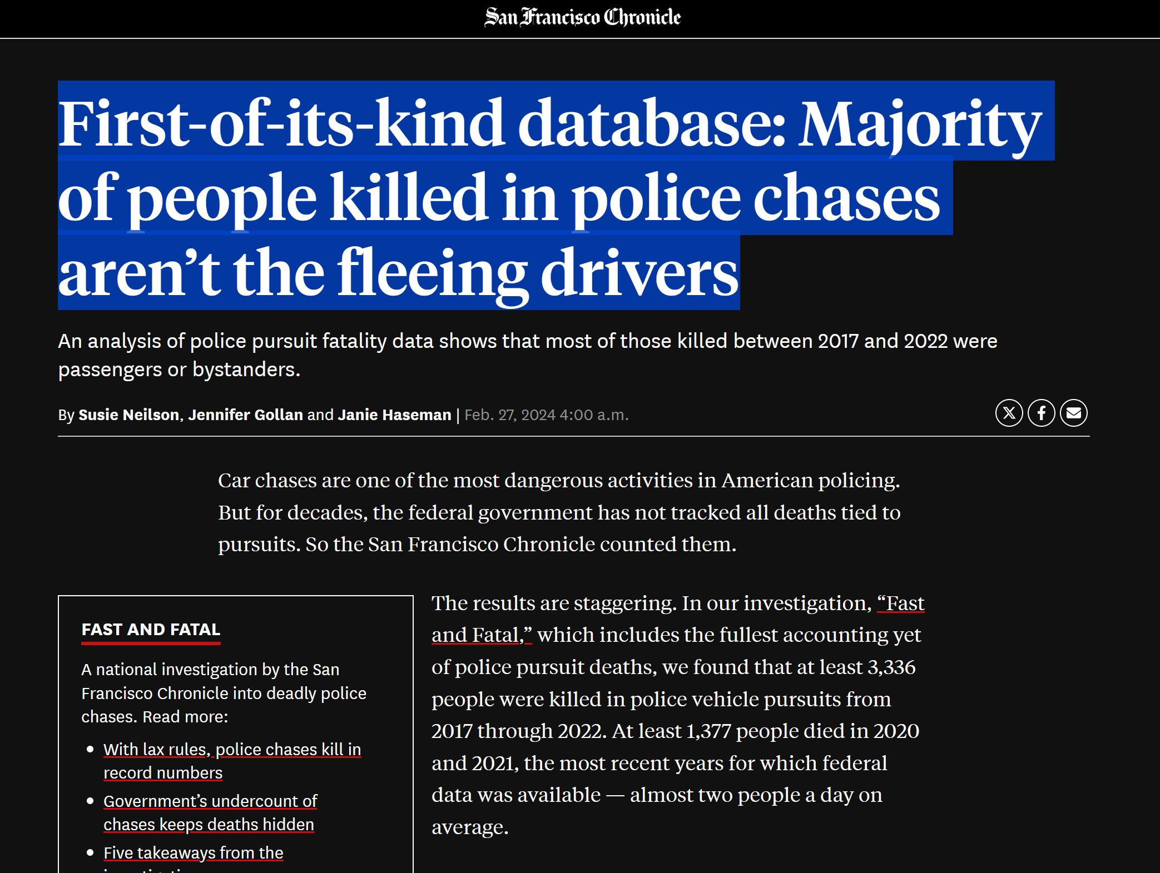
Market Potential and Competition

Slide 12
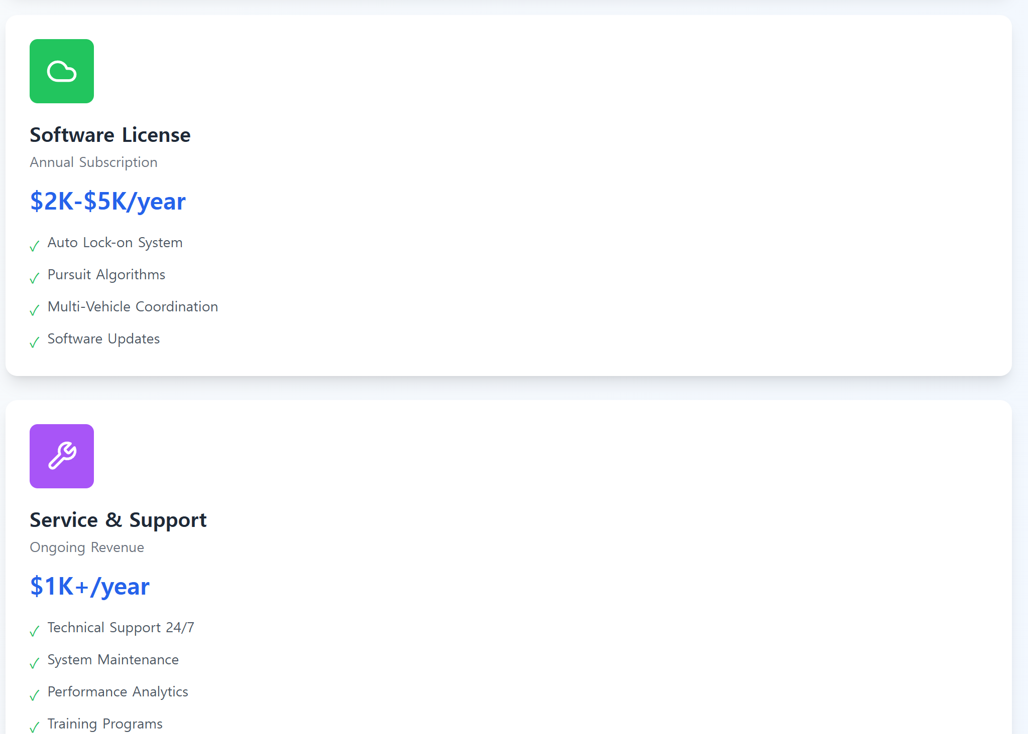
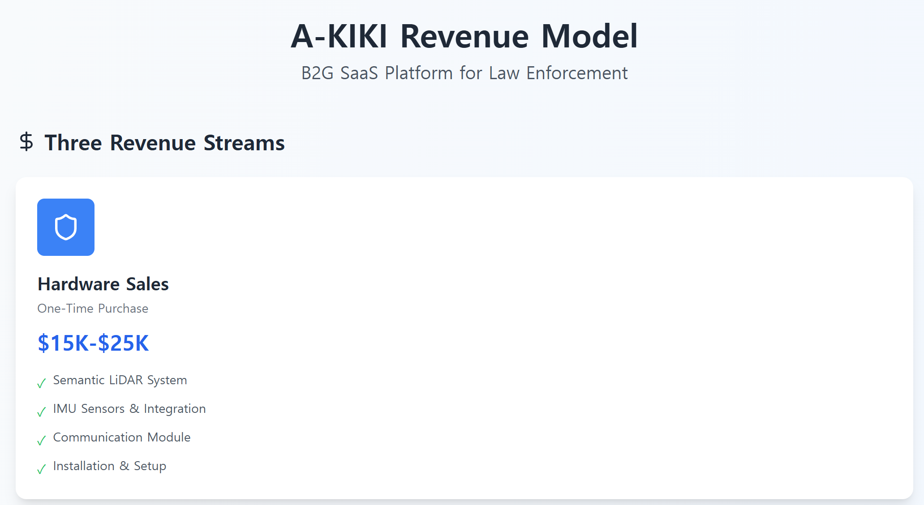
Business Model

Slide 13
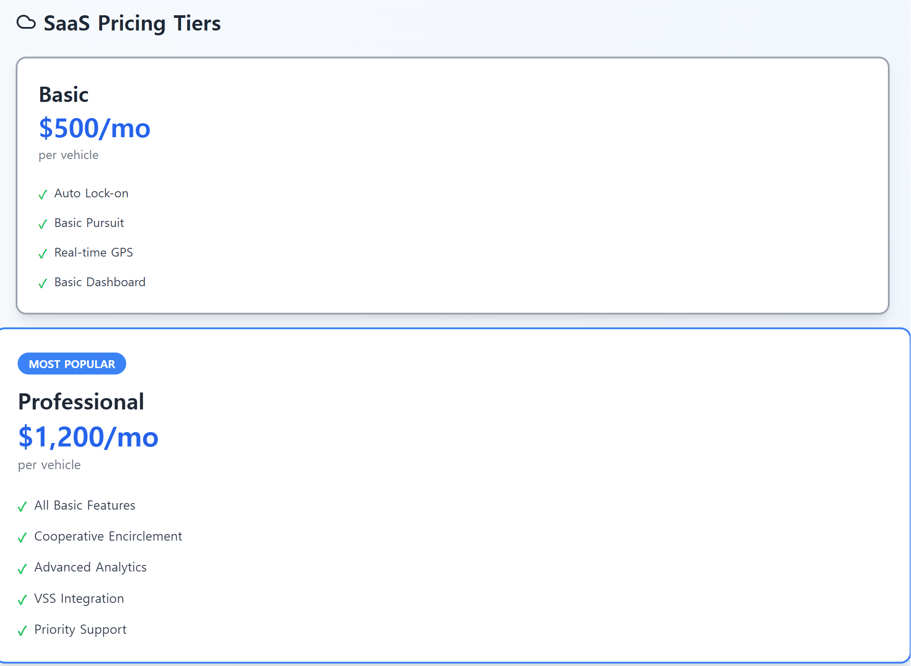
Business Model

Slide 14
Thank you A - kiki✊✊
COPYRIGHT (C) 2025, ECLIPSE FOUNDATION

